Slide 1
Maharishi Library System
Presented by Sundy, Jocyline and Mayra

Slide 2
Team Member
Sundy Thawdarr Shwe : 615698
Jocyline Magero : 615685
Mayra Pullupaxi : 615638

Slide 3
Responsibility
Sundy Thawdarr Shwe – Log In, Add Library Member, Calculate Late Fee
Jocyline Magero– Add New Book, Add Book Copy
Mayra Pullupaxi– Check Out Book, Print Check Out Record

Slide 4
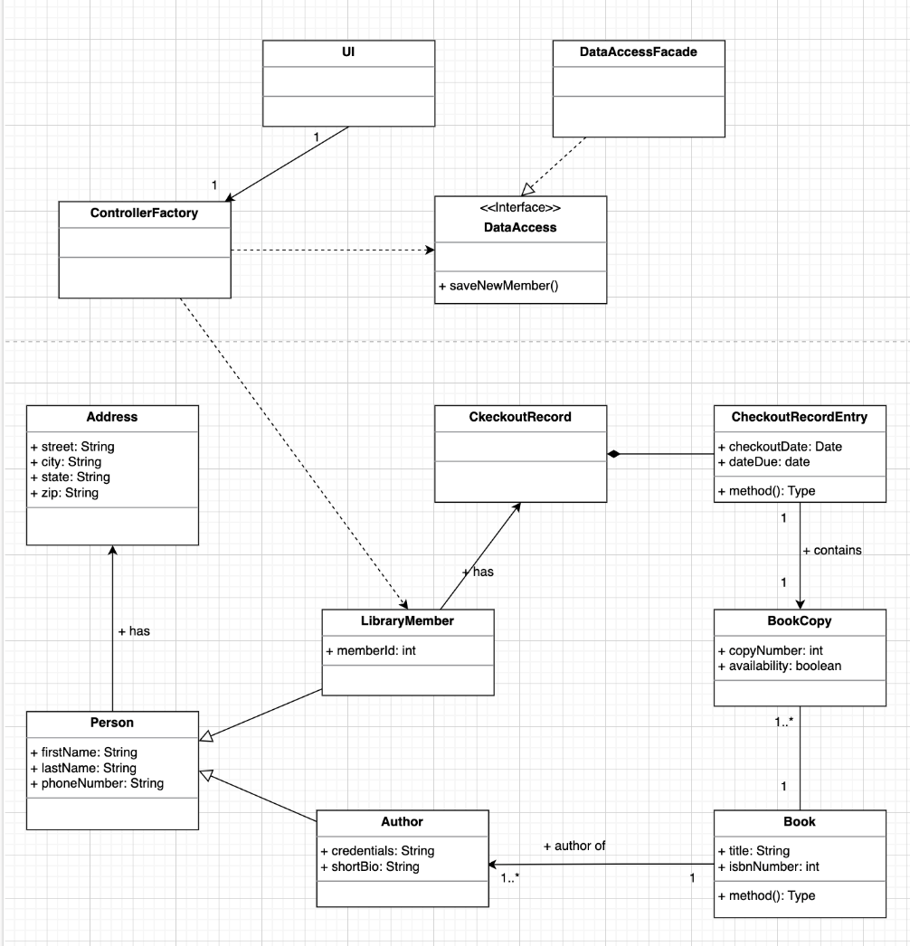
Class Diagram

Slide 5
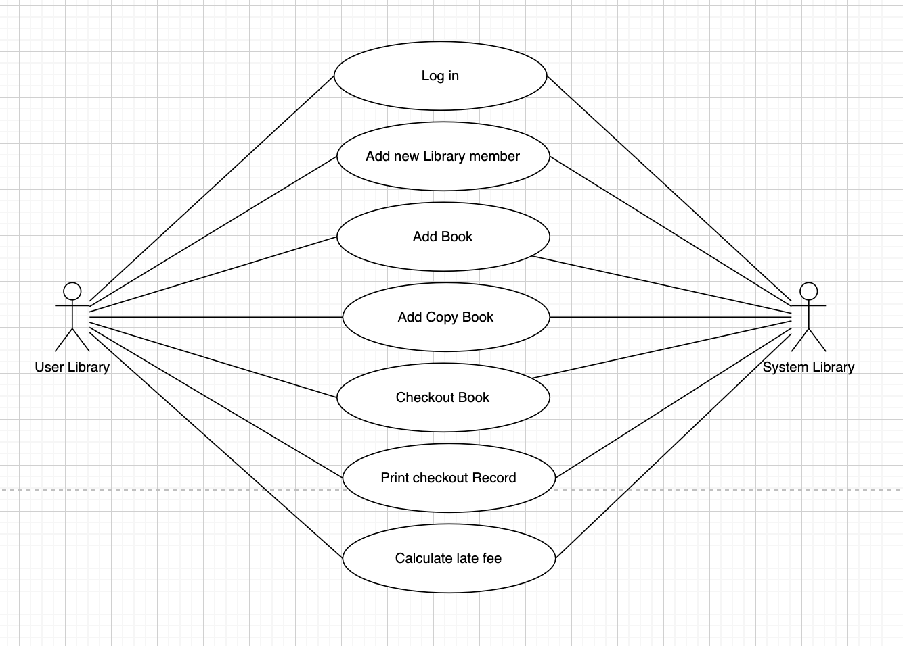
UseCase Diagram

Slide 6
System Structure
Window
Use Case <Interface>
Controller Factory
DataAccess
Controller

Slide 7
System Structure
OOP paradigm
Following S.O.L.I.D Principles as much as we could
Better Parallel Programming
Easier Merging of Codes
Strong Encapsulation

Slide 8
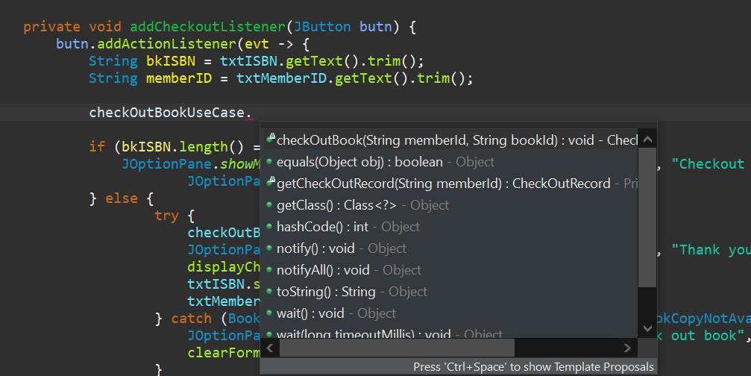
Strong Encapsulation

Slide 9
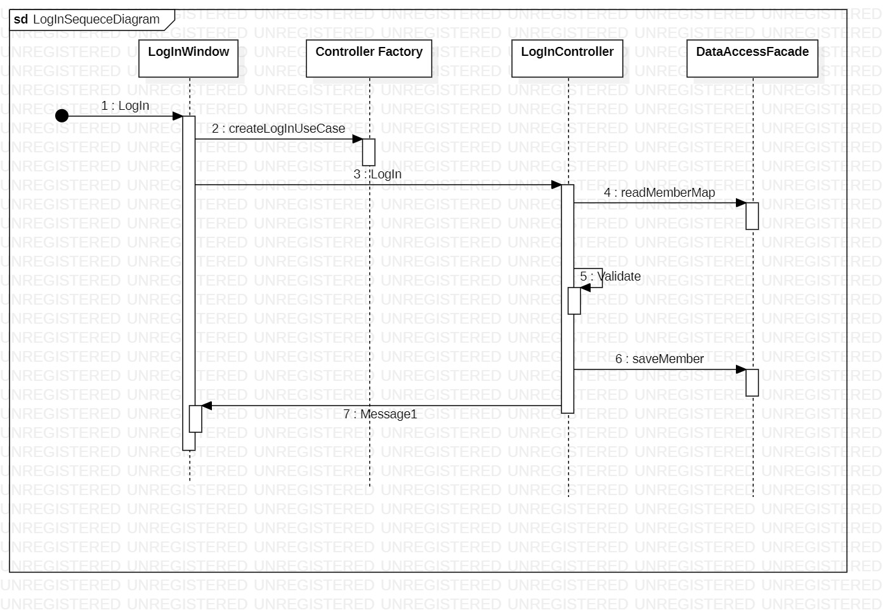
Log In

Slide 10
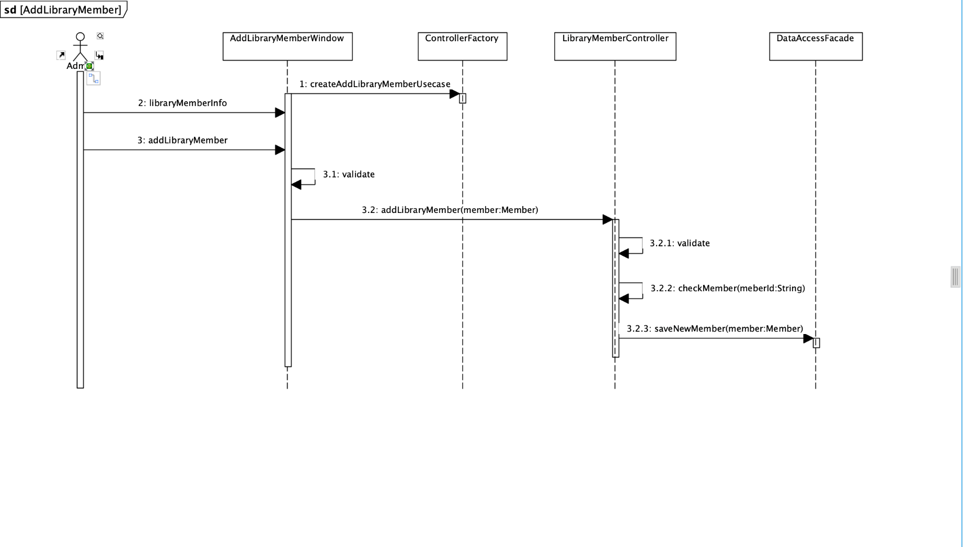
Add Member

Slide 11
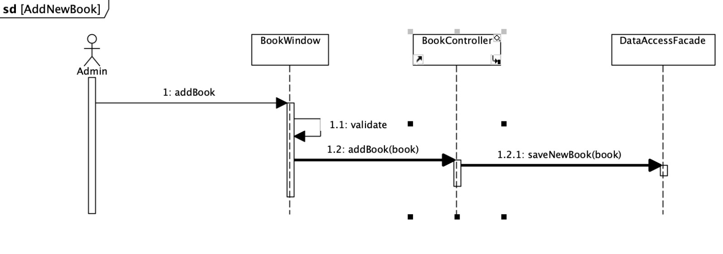
Add Book

Slide 12
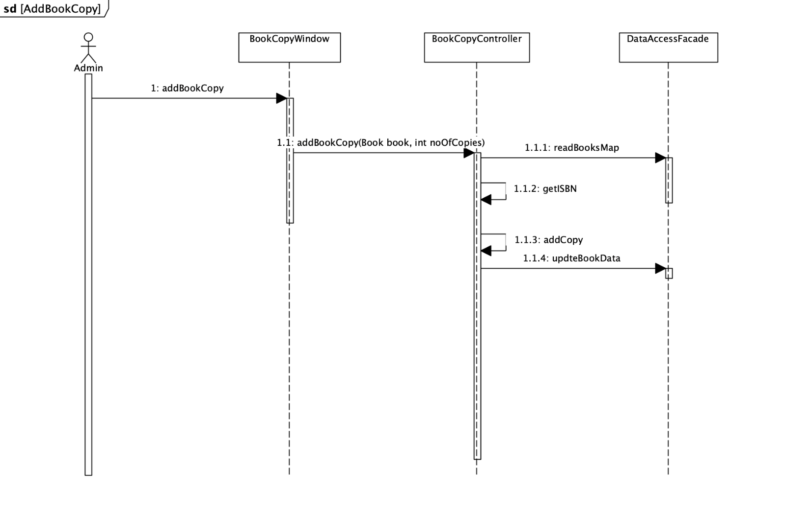
Add Book Copy

Slide 13
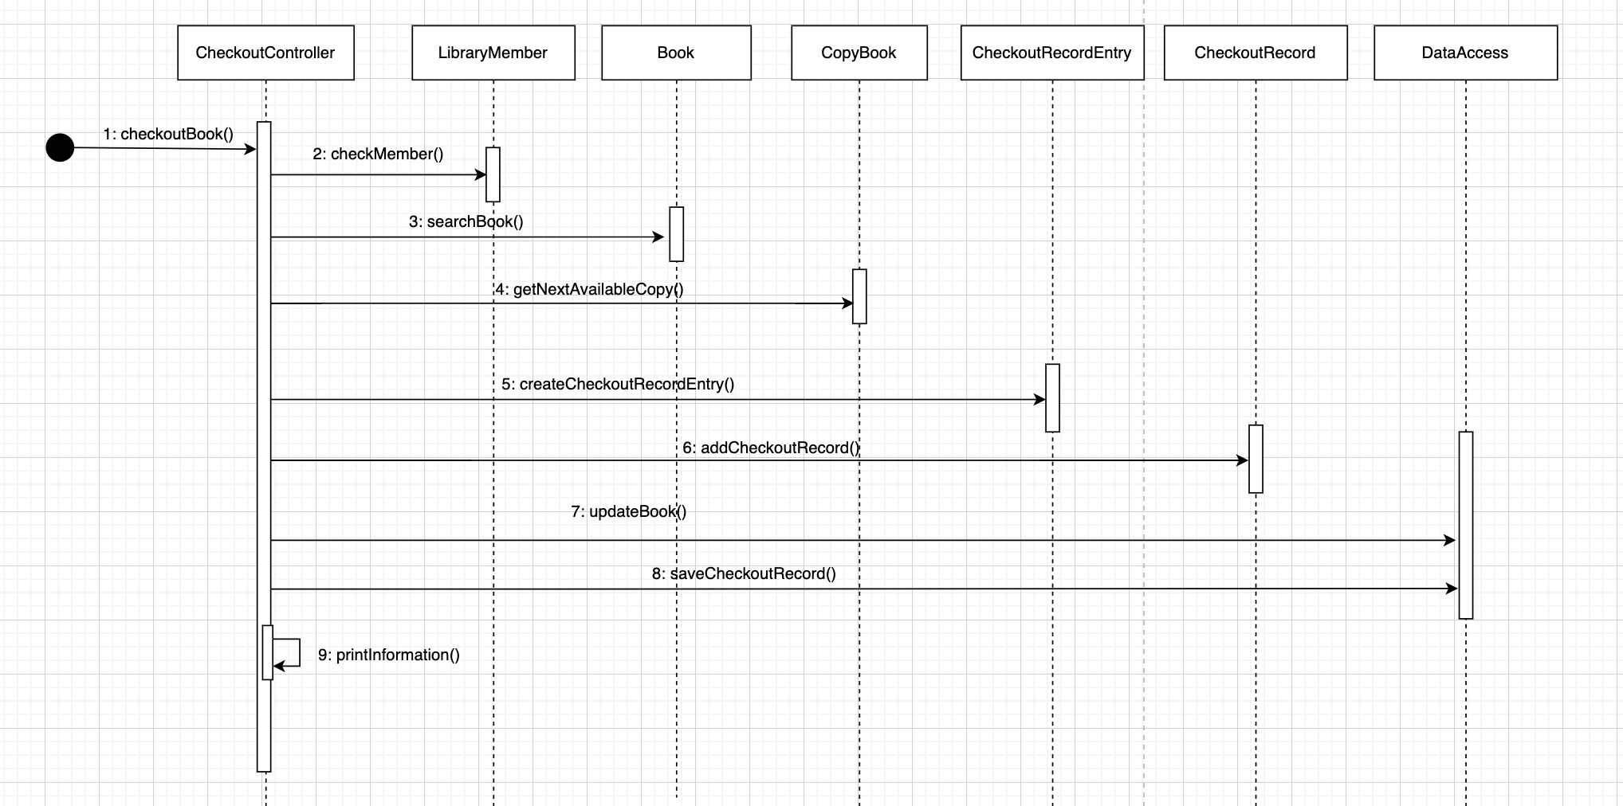
Check Out Book

Slide 14
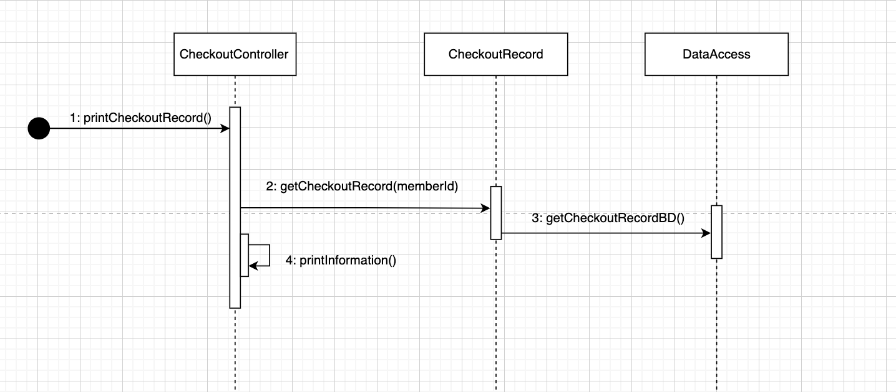
Print Check Out Record

Slide 15
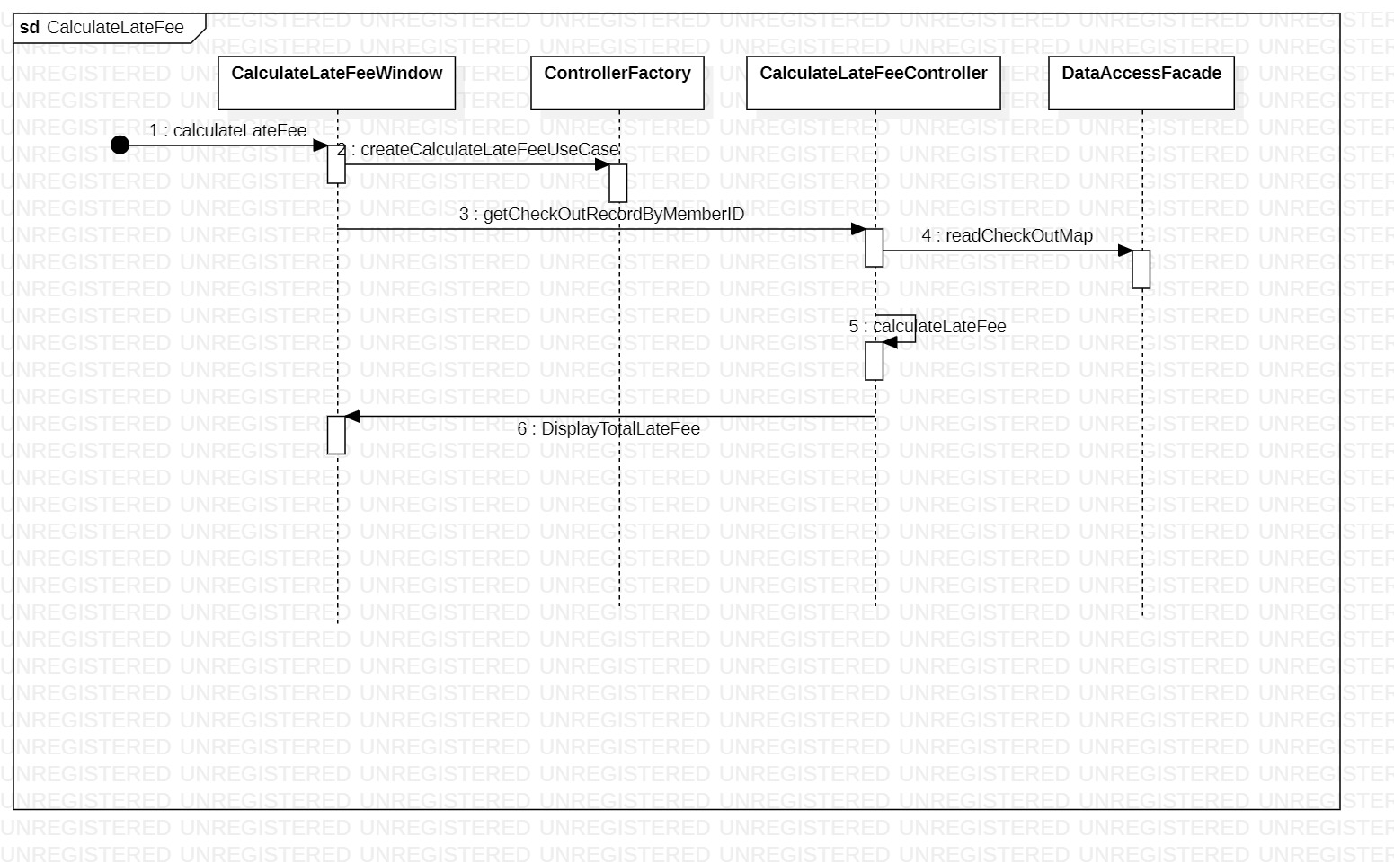
Calculate Late Return Fee

Slide 16
Thank You Prof Micheal Yang and All Our Classmates
From
Sundy, Jocyline and Mayra

